Slide 1
Filtering in Spatial Domain

Slide 2
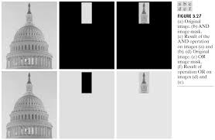

Slide 3
Background
Filter term in “Digital image processing” is referred to the subimage
There are others term to call subimage such as mask, kernel, template, or window
The value in a filter subimage are referred as coefficients, rather than pixels.

Slide 4
Mechanics of spatial filtering
The process consists simply of moving the filter mask from point to point in an image.
At each point (x,y) the response of the filter at that point is calculated using a predefined relationship

Slide 5
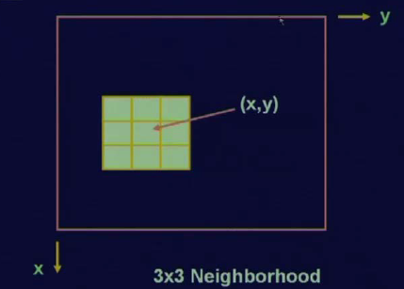
Neighborhood

Slide 6
Linear spatial filtering
w(-1,-1)
w(-1,0)
w(-1,1)
w(0,-1)
w(0,0)
w(0,1)
Pixels of image
The result is the sum of products of the mask coefficients with the corresponding pixels directly under the mask
w(1,-1)
w(1,0)
w(1,1)
f(x-1,y-1)
w(-1,-1)
f(x-1,y)
w(-1,0)
f(x-1,y+1)
w(-1,1)
f(x,y-1)
w(0,-1)
f(x,y)
w(0,0)
f(x,y+1)
w(0,1)
f(x+1,y-1)
Mask coefficients
w(1,-1)
f(x+1,y)
w(1,0)
f(x+1,y+1)
w(1,1)

Slide 7
Note: Linear filtering
The coefficient w(0,0) coincides with image value f(x,y), indicating that the mask is centered at (x,y) when the computation of sum of products takes place.
For a mask of size mxn, we assume that m-2a+1 and n=2b+1, where a and b are nonnegative integer. Then m and n are odd.

Slide 8
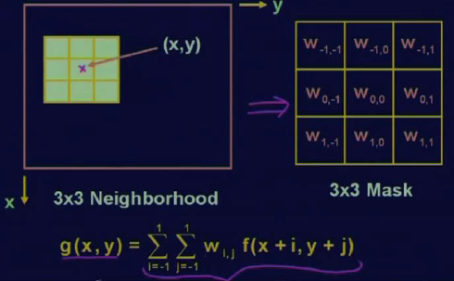
Mask Processing

Slide 9
Smoothing Spatial Filters
Smoothing filters are used for blurring and for noise reduction.
Blurring is used in preprocessing steps, such as removal of small details from an image prior to object extraction, and bridging of small gaps in lines or curves
Noise reduction can be accomplished by blurring

Slide 10
Type of smoothing filtering
There are 2 way of smoothing spatial filters
Smoothing Linear Filters
Order-Statistics Filters

Slide 11
Smoothing Linear Filters
Linear spatial filter is simply the average of the pixels contained in the neighborhood of the filter mask.
Sometimes called “averaging filters”.
The idea is replacing the value of every pixel in an image by the average of the gray levels in the neighborhood defined by the filter mask.

Slide 12
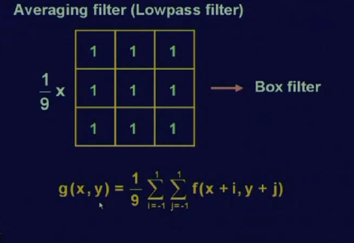
Smoothening Spatial Filters

Slide 13
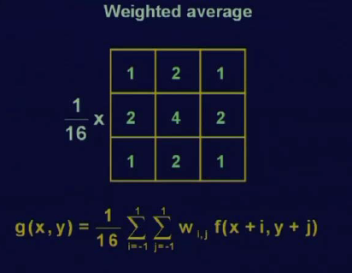
Smoothening Spatial Filters

Slide 14
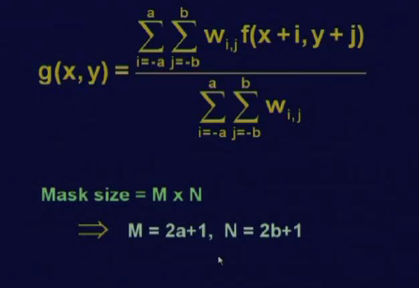
Spatial Filter General Expression

Slide 15
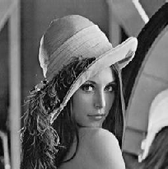
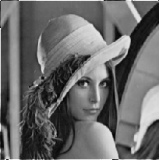
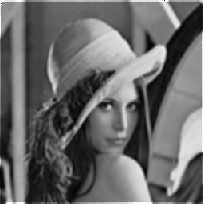

Result of Smoothing Linear Filters
Original Image
[3x3]
[5x5]
[7x7]

Slide 16
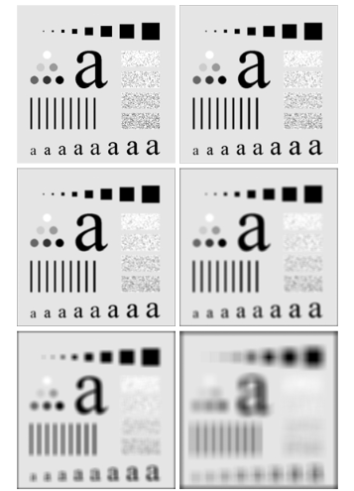
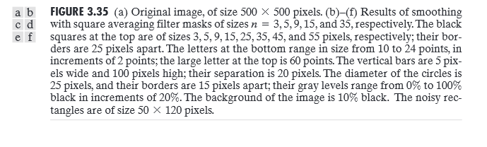

Slide 17
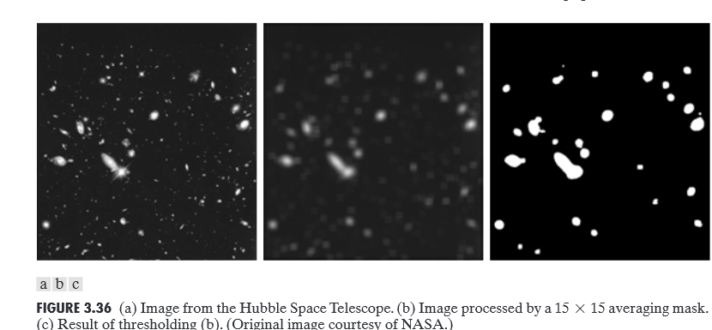

Slide 18
Order-Statistics Filters
Order-statistics filters are nonlinear spatial filters whose response is based on ordering (ranking) the pixels contained in the image area encompassed by the filter, and then replacing the value of the center pixel with the value determined by the ranking result.
Best-known “median filter”

Slide 19
Process of Median filter
Corp region of neighborhood
Sort the values of the pixel in our region
In the MxN mask the median is MxN div 2 +1
10
15
20
20
100
20
20
20
25
10, 15, 20, 20, 20, 20, 20, 25, 100
5th

Slide 20
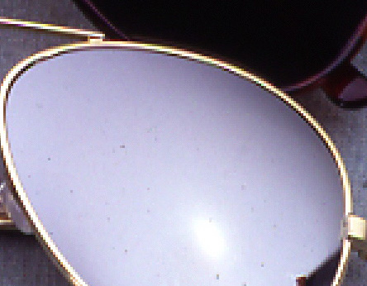
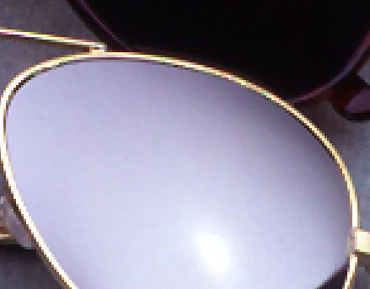
Result of median filter
Noise from Glass effect
Remove noise by median filter

Slide 21
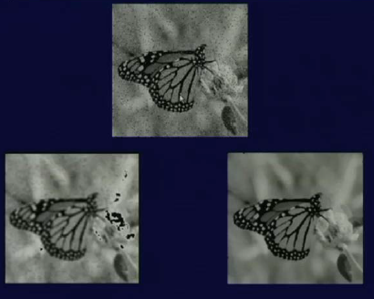
Median Filter

Slide 22
Sharpening Spatial Filters
The principal objective of sharpening is to highlight fine detail in an image or to enhance detail that has been blurred, either in error or as an natural effect of a particular method of image acquisition.

Slide 23
Introduction
The image blurring is accomplished in the spatial domain by pixel averaging in a neighborhood.
Since averaging is analogous to integration.
Sharpening could be accomplished by spatial differentiation.

Slide 24
Foundation
We are interested in the behavior of these derivatives in areas of constant gray level(flat segments), at the onset and end of discontinuities(step and ramp discontinuities), and along gray-level ramps.
These types of discontinuities can be noise points, lines, and edges.

Slide 25
Definition for a first derivative
Must be zero in flat segments
Must be nonzero at the onset of a gray-level step or ramp; and
Must be nonzero along ramps.

Slide 26
Definition for a second derivative
Must be zero in flat areas;
Must be nonzero at the onset and end of a gray-level step or ramp;
Must be zero along ramps of constant slope

Slide 27
Definition of the 1st-order derivative
A basic definition of the first-order derivative of a one-dimensional function f(x) is

Slide 28
Definition of the 2nd-order derivative
We define a second-order derivative as the difference

Slide 29
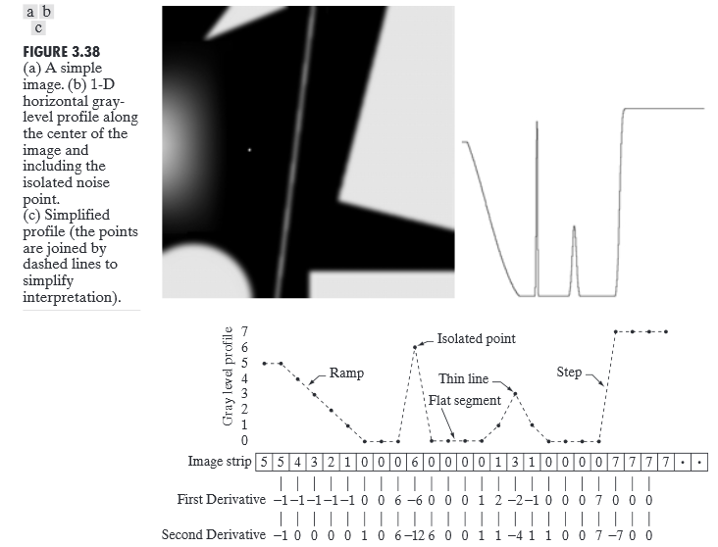
First and Second Order Derivative Response

Slide 30
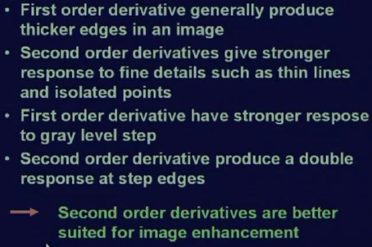
Observations

Slide 31
The Laplacian (2nd order derivative)
Response of isotopic filters is independent of direction of discontinuities in the image to which filter is applied.
Shown by Rosenfeld and Kak[1982] that the simplest isotropic derivative operator is the Laplacian is defined as

Slide 32
Discrete form of derivative
f(x-1,y)
f(x,y)
f(x+1,y)
f(x,y-1)
f(x,y)
f(x,y+1)

Slide 33
2-Dimentional Laplacian
The digital implementation of the 2-Dimensional Laplacian is obtained by summing 2 components
1
1
-4
1
1

Slide 34
Laplacian
0
1
0
1
1
1
1
-4
1
1
-8
1
0
1
0
1
1
1
1
0
1
0
-4
0
1
0
1

Slide 35
Laplacian
0
-1
0
-1
-1
-1
-1
4
-1
-1
8
-1
0
-1
0
-1
-1
-1
-1
0
-1
0
4
0
-1
0
-1

Slide 36
Implementation
If the center coefficient is negative
If the center coefficient is positive
Where f(x,y) is the original image
is Laplacian filtered image
g(x,y) is the sharpen image

Slide 37
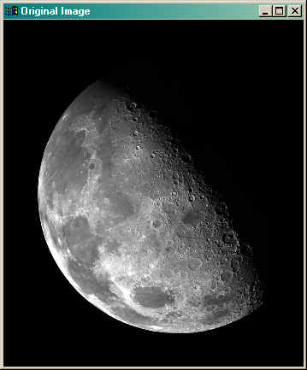
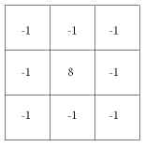
Implementation

Slide 38
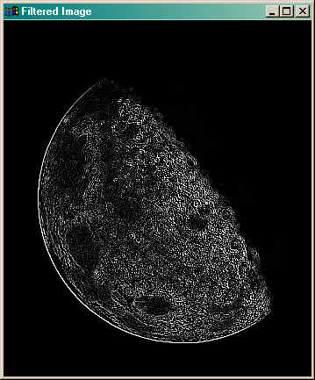
Implementation
Filtered = Conv(image,mask)

Slide 39
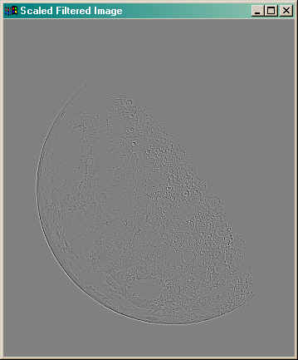
Implementation
filtered = filtered - Min(filtered)
filtered = filtered * (255.0/Max(filtered))

Slide 40
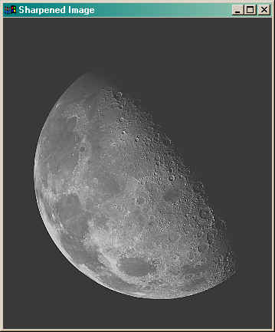
Implementation
sharpened = image + filtered
sharpened = sharpened - Min(sharpened )
sharpened = sharpened * (255.0/Max(sharpened ))

Slide 41
Simplification
We will apply two step to be one mask
0
-1
0
-1
-1
-1
-1
5
-1
-1
9
-1
0
-1
0
-1
-1
-1

Slide 42
Unsharp masking
A process to sharpen images consists of subtracting a blurred version of an image from the image itself. This process, called unsharp masking, is expressed as
Where denotes the sharpened image obtained by unsharp masking, and is a blurred version of

Slide 43
High-boost filtering
A high-boost filtered image, fhb is defined at any point (x,y) as
This equation is applicable general and does not state explicity how the sharp image is obtained

